Slide 1
DIGITAL PORTFOLIO
STUDENT NAME: SOWMIYA M
REGISTER NO AND NMID: 35524U09037/ 8370E1F702D45D5BAF44AE3CCDE19014
DEPARTMENT: 2 - BCA
COLLEGE: GOVERMENT ARTS AND SCIENCE COLLEGE TIRUPATTUR,635901.

Slide 2
PROJECT TITLE
STUDENT DIGITAL PORTFOLIO USING INFORMATION TECHNOLOGY IN DATA ANALYSIS .

Slide 3


AGENDA
Problem Statement
Project Overview
End Users
Tools and Technologies
Portfolio design and Layout
Features and Functionality
Results and Screenshots
Conclusion
Github Link
3/21/2024 Annual Review

Slide 4

PROBLEM STATEMENT
1. *Problem definition*: Clearly define the problem or opportunity. 2. *Business objective*: Specify the goal or outcome desired. 3. *Key metrics*: Identify the metrics to measure success. 4. *Data sources*: Determine the relevant data sources. 5. *Constraints*: Consider any limitations or constraints

Slide 5

PROJECT OVERVIEW
1. *Project objective*: Clearly define the project's goal. 2. *Data sources*: Identify the datasets to be analyzed. 3. *Methodology*: Outline the analytical approaches and techniques. 4. *Expected outcomes*: Specify the insights or results anticipated. 5. *Stakeholders*: Identify the key stakeholders and their interests.

Slide 6

WHO ARE THE END USERS?
1. *Business stakeholders*: Executives, managers, and decision-makers who use insights to inform strategic decisions. 2. *Data analysts*: Professionals who work with data to identify trends, create reports, and visualize insights. 3. *Product managers*: Individuals responsible for product development and optimization. 4. *Marketing teams*: Professionals who use data insights to inform marketing strategies. 5. *Operations teams*: Staff who use data to optimize processes and improve efficiency. These end-users rely on data analysis to drive business outcomes, optimize processes, and inform strategic decisions.

Slide 7

TOOLS AND TECHNIQUES
Data analysis tools:
1. Excel 2. Python (Pandas, NumPy, Matplotlib) 3. R 4. SQL 5. Tableau 6. Power BI 7. Jupyter Notebooks
Data analysis techniques:
1. Descriptive statistics 2. Inferential statistics 3. Data visualization 4. Machine learning 5. Data mining 6. Regression analysis 7. Clustering and segmentation

Slide 8
POTFOLIO DESIGN AND LAYOUT
1. *Introduction*: Overview of skills and experience. 2. *Projects*: Showcase of data analysis projects with descriptions, methodologies, and insights. 3. *Visualizations*: Interactive dashboards, charts, and graphs. 4. *Code snippets*: Examples of programming code (e.g., Python, R, SQL). 5. *Case studies*: In-depth examinations of specific projects or problems. 6. *Certifications and skills*: List of relevant certifications and technical skills. A well-designed portfolio demonstrates data analysis skills, experience, and ability to communicate insights effectively.
8

Slide 9
FEATURES AND FUNCTIONALITY
1. *Data visualization*: Charts, graphs, and dashboards. 2. *Statistical modeling*: Regression, clustering, and forecasting. 3. *Data mining*: Identifying patterns and relationships. 4. *Data manipulation*: Cleaning, transforming, and merging data
5. *Reporting*: Generating insights and summaries. 6. *Predictive analytics*: Forecasting future outcomes. 7. *Data storytelling*: Communicating insights effectively. These features enable data analysts to extract insights, identify trends, and drive informed decision-making

Slide 10

RESULTS AND SCREENSHOTS
To provide data analysis results and screenshots, I'll need more context about the analysis, such as:
1. What data are you analyzing?
2. What tools are you using (e.g., Excel, Python, Tableau)?
3. What insights are you trying to convey?
If you provide more details, I can help create sample results and describe how to effectively present them with screenshots.
3/21/2024 Annual Review
10

Slide 11
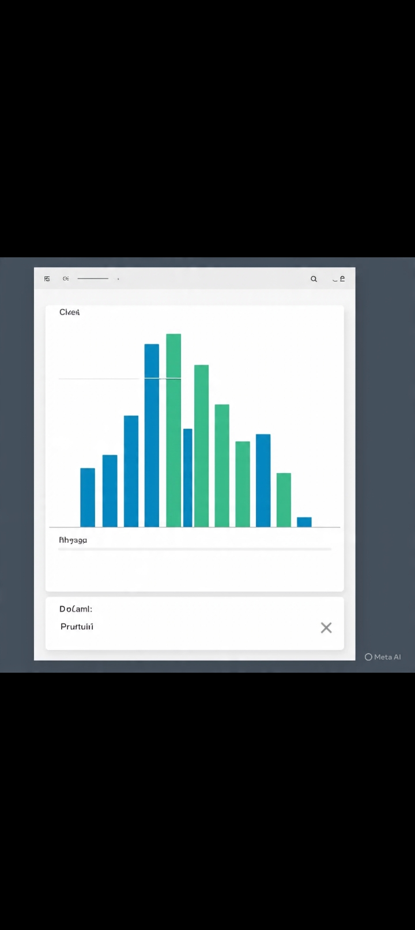


Slide 12
CONCLUSIONS
Data analysis enables organizations to extract insights from data, driving informed decision-making and business outcomes. By applying statistical and analytical techniques, organizations can identify trends, patterns, and correlations, ultimately gaining a competitive edge and improving performance. Effective data analysis informs strategic decisions, optimizes processes, and enhances customer experiences.
12

Slide 13
GITUP LINK
.
https://github.com/24bcanm37-dot/NAANMUDHALVANSOWMIYA2025.git

